Slide 1

Chapter 6
Low-Level Programming Languages and Pseudocode

Slide 2
Chapter Goals (1 of 3)
List the operations that a computer can perform
Describe the important features of the Pep/9 virtual machine
Distinguish between immediate addressing mode and direct addressing mode
Write a simple machine-language program
Distinguish between machine language and assembly language

Slide 3
Chapter Goals (2 of 3)
Describe the steps in creating and running an assembly-language program
Write a simple program in assembly language
Distinguish between instructions to the assembler and instructions to be translated
Distinguish between following an algorithm and developing one
Describe the pseudocode constructs used in expressing an algorithm

Slide 4
Chapter Goals (3 of 3)
Use pseudocode to express an algorithm
Describe two approaches to testing
Design and implement a test plan for a simple assembly-language program

Slide 5
Computer Operations
Computer
A programmable electronic device that can store, retrieve, and process data
Data and instructions to manipulate the data are logically the same and can be stored in the same place
What operations can a computer execute?

Slide 6
Machine Language (1 of 2)
Machine Language
The language made up of binary coded instructions built into the hardware of a particular computer and used directly by the computer
Why would anyone choose to use machine language?
(Hint: They had no choice. Why?)
Why would anyone choose to use machine language?
(Hint: they had no choice. Why?)

Slide 7
Machine Language (2 of 2)
Characteristics of machine language:
Every processor type has its own specific set of machine instructions
The digital logic of the CPU recognizes the binary representations of the instructions
Each machine-language instruction does only one (typically) very low-level task

Slide 8
Pep/9 Virtual Computer
Virtual Computer
A hypothetical machine designed to contain the important features of a real computer that we want to illustrate
Pep/9
A virtual computer designed by Stanley Warford that has 40 machine-language instructions
No, we are not going to cover all of them!

Slide 9
Features in Pep/9
Pep/9 Registers/Status Bits Covered
The program counter (“PC”) (contains the address of the next instruction to be executed)
The instruction register (“IR”) (contains a copy of the instruction being executed)
The accumulator (“A”) (used to hold data and results of operations)
The main memory unit is made up of 64KB (65,636 bytes) of storage

Slide 10
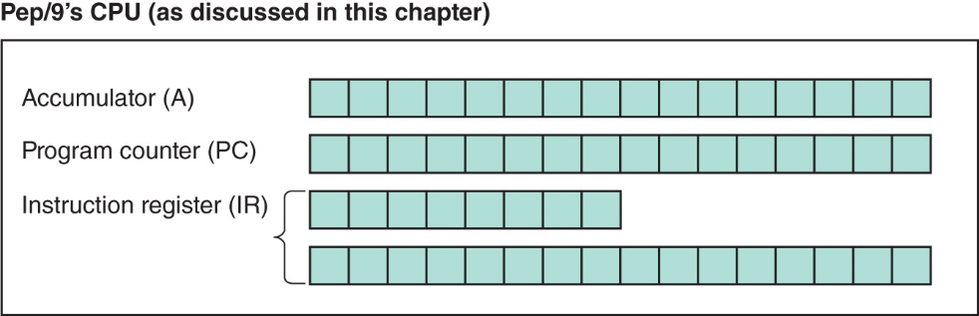
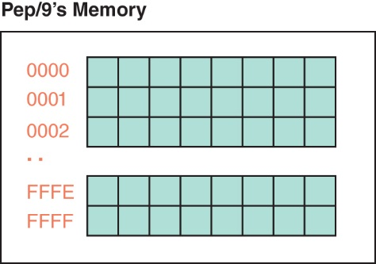
Architecture of Pep/9
Pep/9's architecture

Slide 11
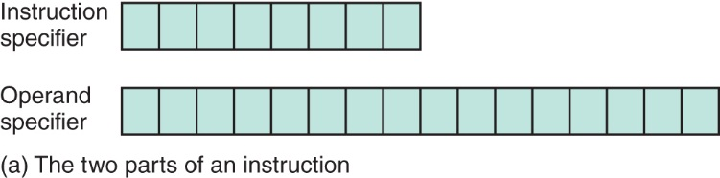
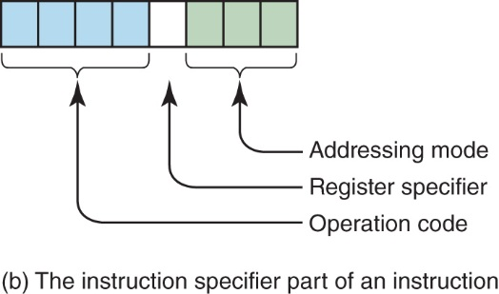
Instruction Format (1 of 3)
Pep/9 instruction format

Slide 12
Instruction Format (2 of 3)
Operation Code
Specifies which instruction is to be carried out
Register Specifier
Specifies which register is to be used (for our purposes it always specifies the accumulator)
Addressing-mode Specifier
Says how to interpret the operand part of the instruction

Slide 13
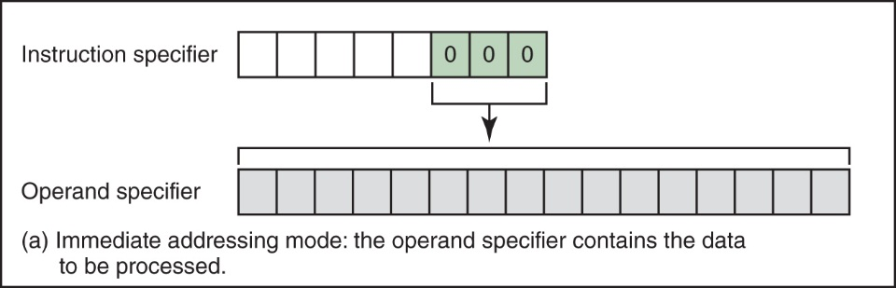
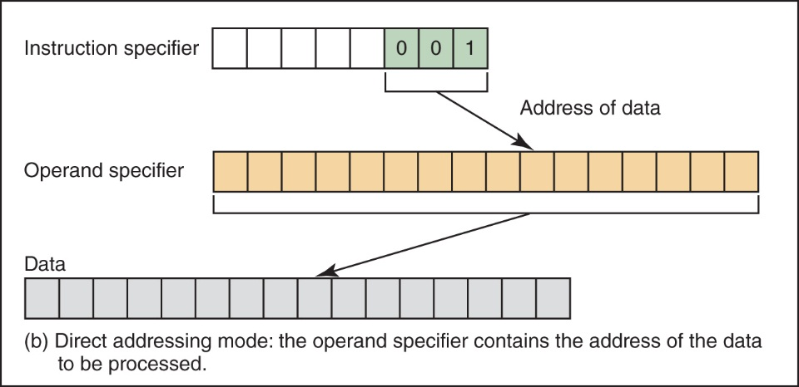
Instruction Format (3 of 3)
The difference between immediate addressing mode and direct addressing mode

Slide 14
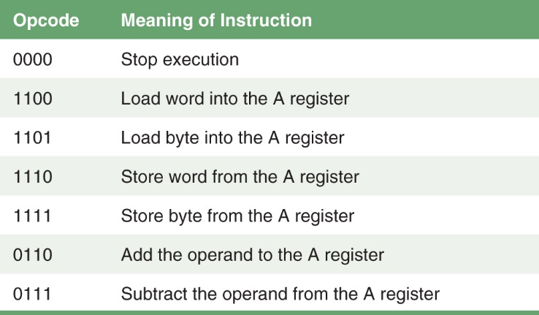
Sample Instructions (1 of 3)
Subset of Pep/9 instructions

Slide 15
Sample Instructions (2 of 3)
Loading a value into the accumulator:
Instruction specifier
Operand specifier
Instruction specifier
Operand specifier

Slide 16
Sample Instructions (3 of 3)
Adding an operand to the accumulator:
Instruction specifier
Operand specifier

Slide 17
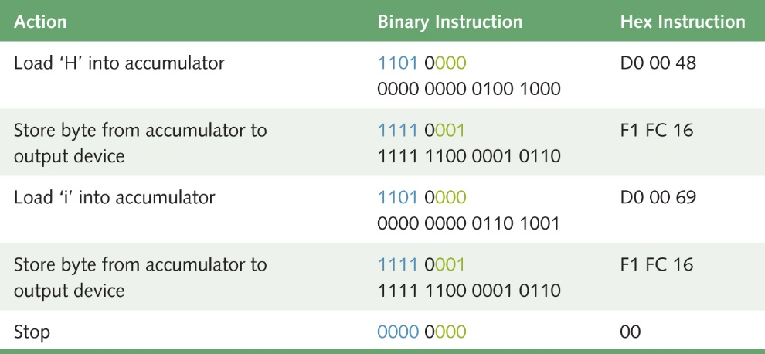
Writing "Hi"

Slide 18
Pep/9 Simulator (1 of 4)
Pep/9 Simulator
A program that behaves just like the Pep/9 virtual machine behaves
To run a program:
Enter the hexadecimal code, byte by byte, with blanks between each

Slide 19
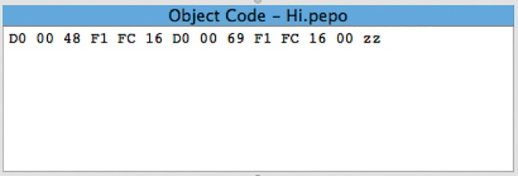
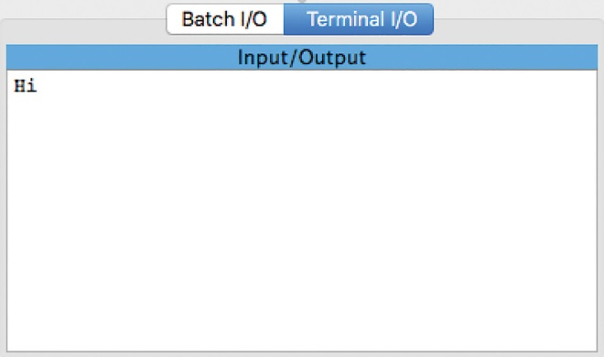
Pep/9 Simulator (2 of 4)

Slide 20
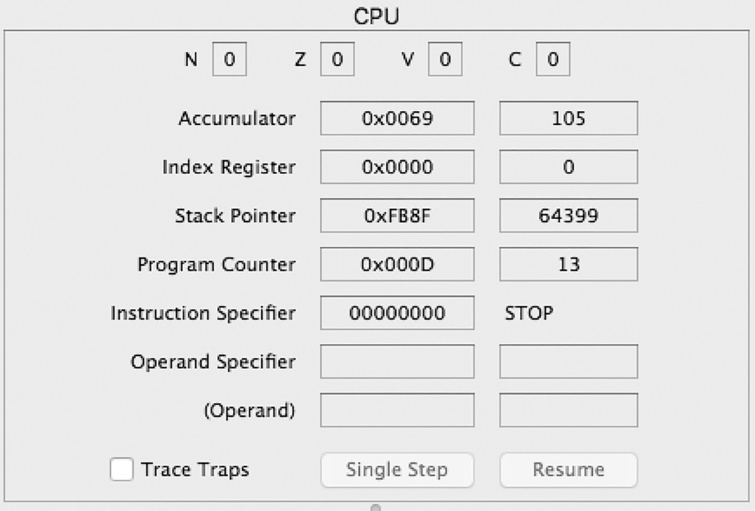
Pep/9 Simulator (3 of 4)

Slide 21
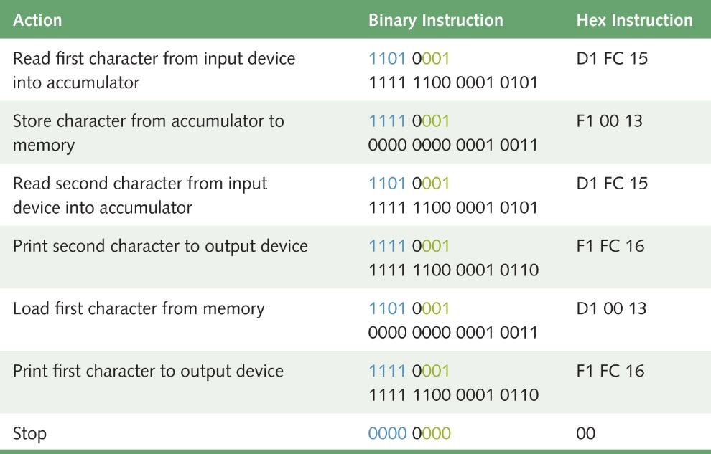
Pep/9 Simulator (4 of 4)

Slide 22
Assembly Language
Assembly Language
A language that uses mnemonic codes to represent machine-language instructions
Assembler
A program that reads each of the instructions in mnemonic form and translates it into the machine-language equivalent

Slide 23
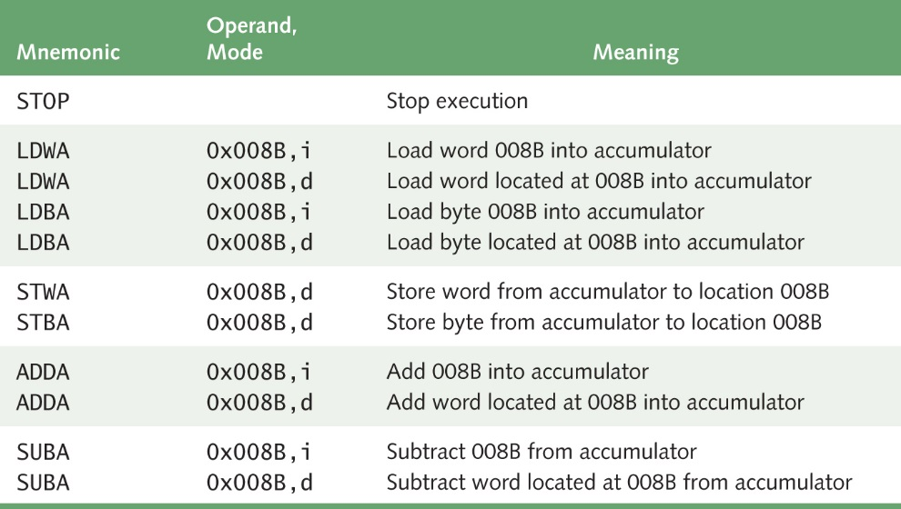
Pep/9 Assembly Language (1 of 8)
Remember
the
difference
between
immediate
and
direct
addressing?
i : immediate
d: direct

Slide 24
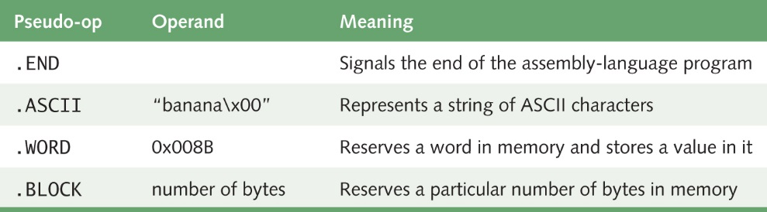
Pep/9 Assembly Language (2 of 8)
What is the difference between operations
and pseudo operations?

Slide 25
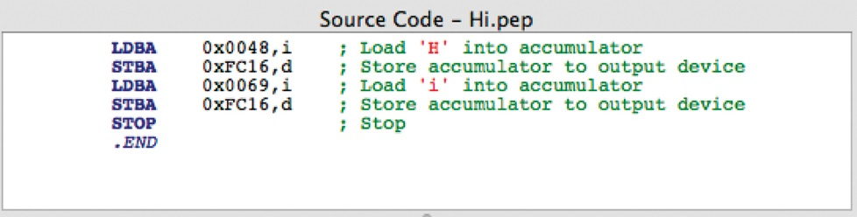
Pep/9 Assembly Language (3 of 8)
Program to write "Hi"
25
Notes:
25

Slide 26
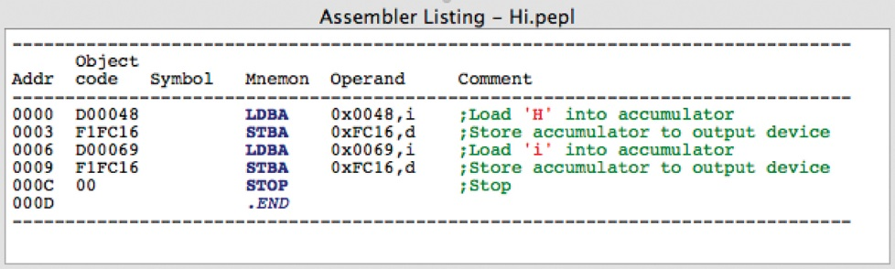
Pep/9 Assembly Language (4 of 8)
An assembler listing:
26
Notes:
26

Slide 27
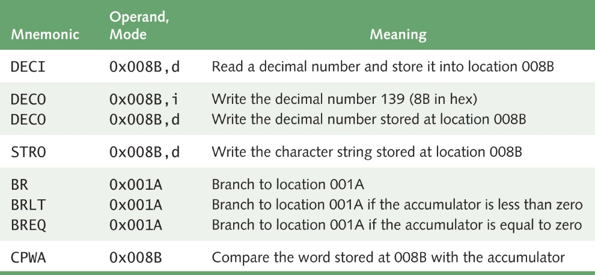
Pep/9 Assembly Language (5 of 8)
Outputting numbers and branch instructions:
27
Notes:
27

Slide 28
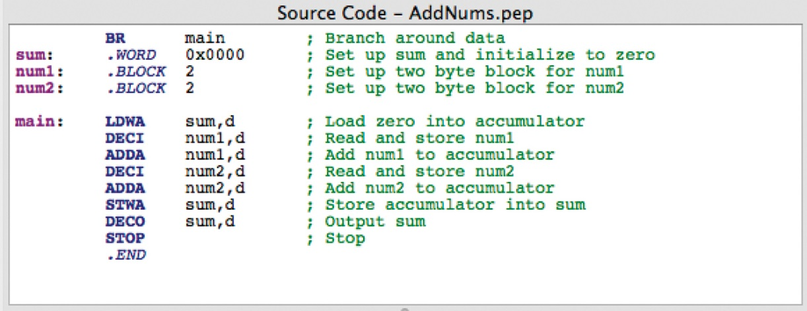
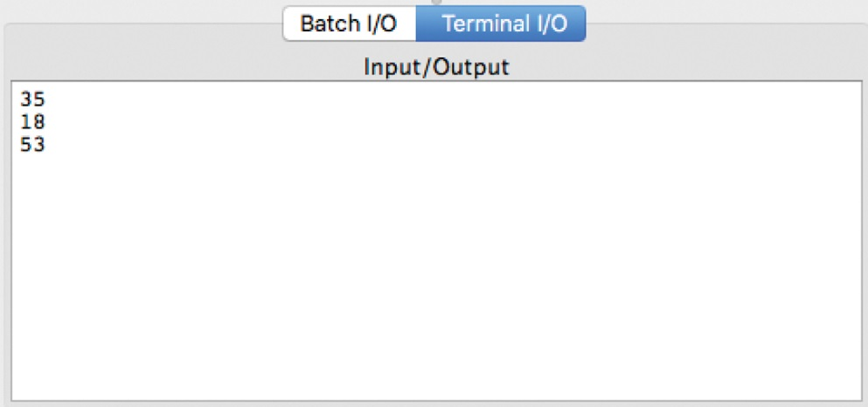
Pep/9 Assembly Language (6 of 8)
A program that reads two numbers and adds them:
28
Notes:
28

Slide 29
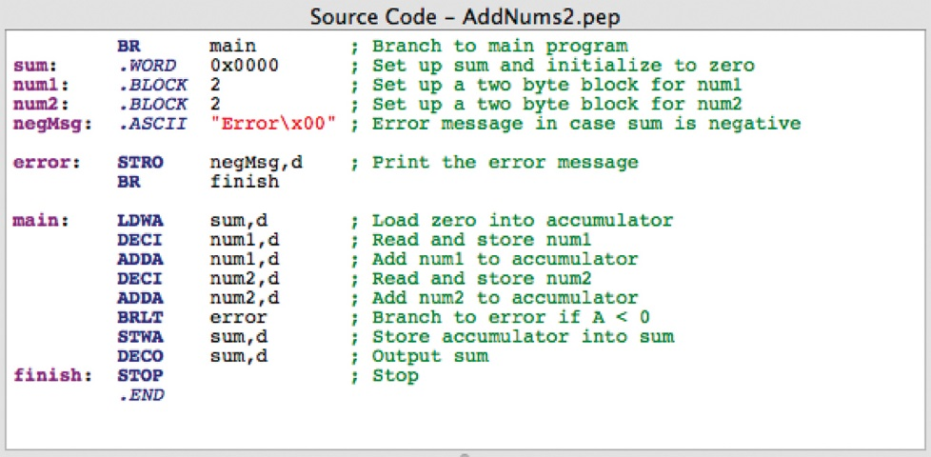
Pep/9 Assembly Language (7 of 8)
A variation on that program that prints an error message
if the sum is negative:
29
Notes:
29

Slide 30
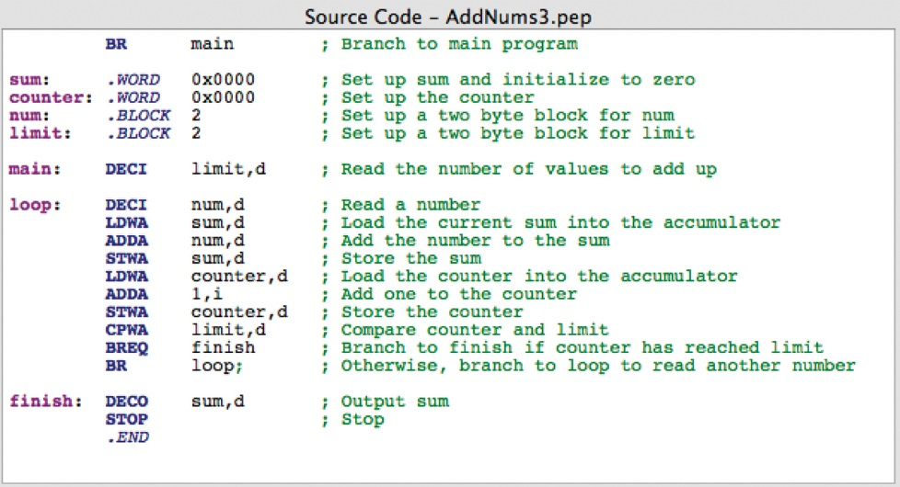
Pep/9 Assembly Language (8 of 8)
A program that uses a loop to read and sum multiple
numbers:
© Claus Hampel/ullstein bild/Getty images
30
Notes:
30

Slide 31
Pseudocode
Pseudocode
A mixture of English and formatting to make the steps in an algorithm explicit
Algorithm to convert base-10 number to other bases
While (the quotient is not zero)
Divide the decimal number by the new base
Make the remainder the next digit to the left in the answer
Replace the original decimal number with the quotient

Slide 32
Following an Algorithm
Algorithm for preparing a Hollandaise sauce
IF concerned about cholesterol
Put butter substitute in a pot
ELSE
Put butter in a pot
Turn on burner
Put pot on the burner
WHILE (NOT bubbling)
Leave pot on the burner
Put other ingredients in the blender
Turn on blender
WHILE (more in pot)
Pour contents into blender in slow stream
Turn off blender

Slide 33
Pseudocode
Pseudocode
A way of expressing algorithms that uses a mixture of English phrases and indentation to make the steps in the solution explicit
There are no grammar rules in pseudocode, but it’s important to be consistent and unambiguous

Slide 34
Following Pseudocode (1 of 2)
While (the quotient is not zero)
Divide the decimal number by the new base
Make the remainder the next digit to the left in the answer
Replace the original decimal number with
What is 93 in base 8?
93/8 gives 11 remainder 5
11/6 gives 1 remainder 3
1/ 8 gives 0 remainder 1
answer 1 3 5

Slide 35
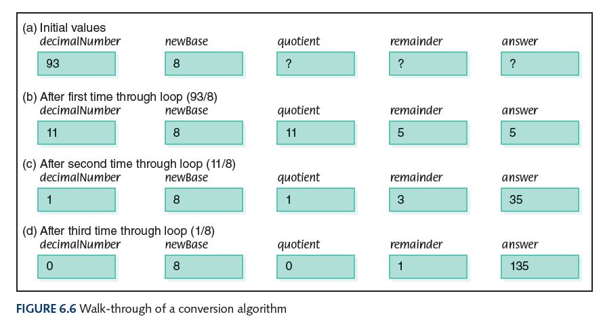
Following Pseudocode (2 of 2)

Slide 36
Pseudocode Functionality (1 of 5)
Variables
Names of places to store values
quotient, decimalNumber, newBase
Assignment
Storing the value of an expression into a variable
Set quotient to 64
quotient <-- 64
quotient <-- 6 * 10 + 4

Slide 37
Pseudocode Functionality (2 of 5)
Output
Printing a value on an output device
Write, Print
Input
Getting values from the outside word and storing them into variables
Get, Read

Slide 38
Pseudocode Functionality (3 of 5)
Selection
Making a choice to execute or skip a statement (or group of statements)
Read number
IF (number < 0)
Write number + " is less than zero."
or
Write "Enter a positive number."
Read number
IF(number < 0)
Write number + " is less than zero."
Write "You didn't follow instructions."

Slide 39
Pseudocode Functionality (4 of 5)
Selection
Choose to execute one statement (or group of statements) or another statement (or group of statements)
IF ( age < 12 )
Write "Pay children's rate"
Write "You get a free box of popcorn"
ELSE IF ( age < 65 )
Write "Pay regular rate"
ELSE
Write "Pay senior citizens rate"

Slide 40
Pseudocode Functionality (5 of 5)
Repetition
Repeating a series of statements
Set count to 1
WHILE ( count < 10)
Write "Enter an integer number"
Read aNumber
Write "You entered " + aNumber
Set count to count + 1

Slide 41
Pseudocode Example (1 of 3)
Problem: Read in pairs of positive numbers and print each pair in order.
WHILE (not done)
Write "Enter two values separated by blanks"
Read number1
Read number2
Print them in order

Slide 42
Pseudocode Example (2 of 3)
How do we know when to stop?
Let the user tell us how many
Print them in order?
If first number is smaller
print first, then second
Otherwise
print second, then first
42
Notes:
42

Slide 43
Pseudocode Example (3 of 3)
Write "How many pairs of values are to be entered?"
Read numberOfPairs
Set numberRead to 0
WHILE (numberRead < numberOfPairs)
Write "Enter two values separated by a blank; press return"
Read number1
Read number2
IF(number1 < number2)
Print number1 + " " + number2
ELSE
Print number2 + " " number1
Increment numberRead
43
Notes:
43

Slide 44
Walk Through
Data Fill in values during each iteration
3 numberRead number1 number2
55 70
2 1
33 33
numberOfPairs

Slide 45
Translating Pseudocode
To What?
Assembly language
Very detailed and time consuming
High-level language
Easier, as you'll see in Chapter 9
45
Notes:
45

Slide 46
Testing (1 of 2)
Test Plan
A document that specifies how many times and with what data the program must be run in order to thoroughly test it
Code Coverage
An approach that designs test cases by looking at
the code
Data Coverage
An approach that designs test cases by looking at the allowable data values
What does “thoroughly” mean?

Slide 47
Testing (2 of 2)
Test Plan Implementation
Using the test cases outlined in the test plan to verify that the program outputs the predicted results

Slide 48
Important Threads (1 of 3)
Operations of a Computer
Computer can store, retrieve, and process data
Computer’s Machine Language
A set of instructions the machine’s hardware is built to recognize and execute
Machine-language Programs
Written by entering a series of these instructions in binary form

Slide 49
Important Threads (2 of 3)
Pep/9: A Virtual Computer with One Register (A) and Two-part Instructions:
One part tells which action the instruction performs; the other part details where the data to be used can be found
Pep/9 Assembly Language
A language that permits the user to enter mnemonic codes for each instruction rather than binary numbers
Pseudocode
Shorthand-type language people use to express algorithms

Slide 50
Important Threads (3 of 3)
Testing Programs
All programs must be tested; code coverage testing and data coverage (black-box testing) are two common approaches

Slide 51
Ethical Issues
Software Piracy and Copyrighting
Have you ever "borrowed" software from a friend?
Have you ever "lent" software to a friend?
According to IDC, lowering software piracy by 10% over the next 4 years would create 500,000 jobs

Slide 52
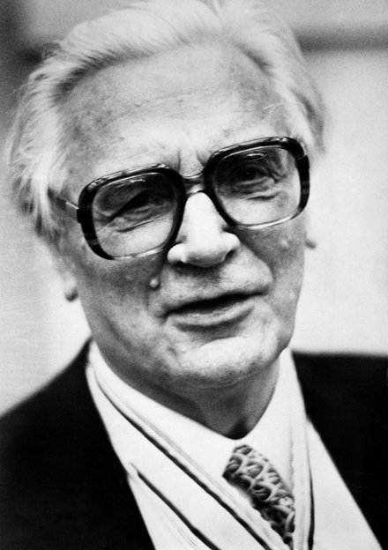
Who Am I?
Turing, Atanasoff, Eckert, and Mauchly were my contemporaries.
Why were we unaware of each other’s work?
© Claus Hampel/ullstein bild/Getty images

Slide 53
Do You Know?
How is a computer data base helping endangered species?
What would chess grandmaster Jan Helm Donner do if he had a hammer?
What are Nigerian check scams?
Why does an anthropologist work for Intel?
What is the Music Genome Project?
What music streaming website uses the Music Genome Project?
What is the difference between certification and licensing?

